Slide 1
The Business Case for EDI
Provided by REMEDI - your partner in EDI and B2B Integration.

Slide 2
Today’s Business Environment
Today, your supply chain partners are not located across town or even in the same area code anymore.
Most likely, you’re dealing with people in other time zones and other continents.
Sharing accurate information quickly is a must; no one can afford to miss documents such as invoices, advance shipping notices, or remittances.
Provided by REMEDI - your partner in EDI and B2B Integration.
2

Slide 3
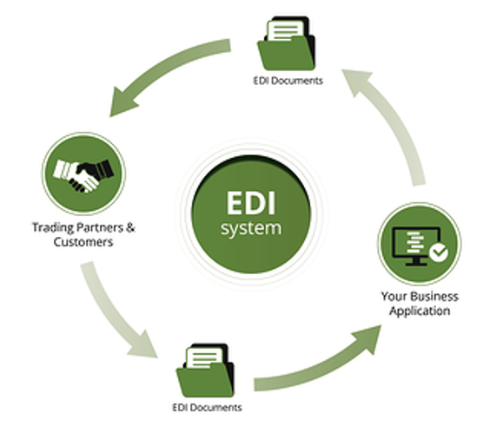
EDI: Allowing You to Communicate Clearly, Quickly, and Accurately
That is where EDI comes into the picture. EDI (Electronic Data Interchange) is:
a computer-to-computer exchange of documents in a standard format between trading partners
automated, thus making it faster than other methods of information transfer
3
Provided by REMEDI - your partner in EDI and B2B Integration.
3

Slide 4
What Are the Benefits of EDI? COST SAVINGS
Human error costs companies millions of dollars each year. Because EDI is automated, there’s almost no need for human intervention and less chance of human error.
Thanks to automating the flow of information, EDI is less expensive than other methods of sending information.
Paper-based methods of storing and transmitting information are pricey; researchers estimate that companies spend $8 billion a year managing paper. EDI systems eliminate this costly process.
4
Provided by REMEDI - your partner in EDI and B2B Integration.
4

Slide 5
What Are the Benefits of EDI? ACCURACY
EDI consumes information directly from the system of record, meaning that there is no need for manual data entry.
That significantly reduces the occurrence of errors.
5
Provided by REMEDI - your partner in EDI and B2B Integration.
5

Slide 6
What Are the Benefits of EDI? SPEED
With EDI, you do not have to wait for an email, a fax, or even snail mail.
You receive information almost instantly, meaning order to shipment times can be cut by 50-60%.
If you’re a supplier, you can get your inventory out the door faster.
If you’re a customer, you receive your order faster.
6
Provided by REMEDI - your partner in EDI and B2B Integration.
6

Slide 7
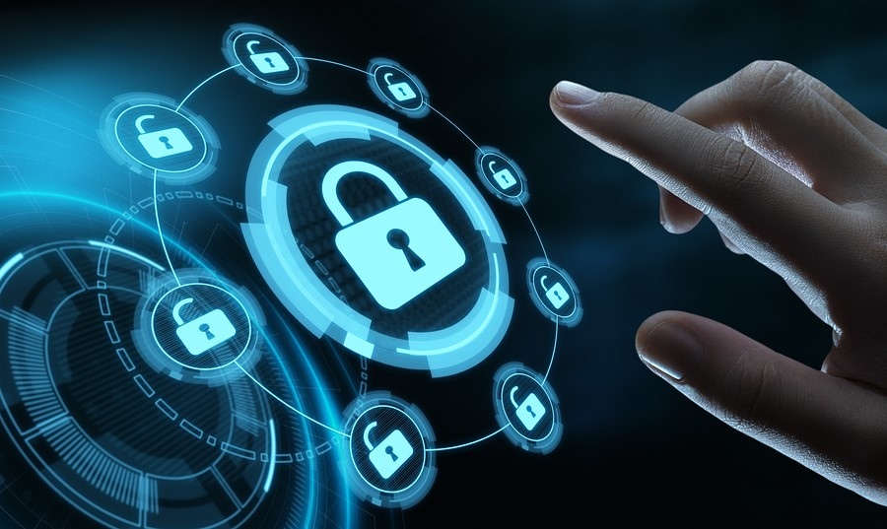
What Are the Benefits of EDI? SECURITY
EDI has built-in security measures.
Only authorized users have access.
Information cannot be changed when it is in transit, so what you send is what the other party receives.
Many EDI systems come with archive tracking and audit capabilities.
7
Provided by REMEDI - your partner in EDI and B2B Integration.
7

Slide 8
What Are the Benefits of EDI? EFFICIENCY
All of the aforementioned benefits lead to greater efficiency.
When your information is secure, accurate, and delivered quickly and cost-effectively, the process of data transmission is more efficient.
Because information is transmitted more efficiently, other operations can move more efficiently, too (such as order fulfillment and payments).
Greater efficiency in your processes can lead to significant cost reduction over time.
8
Provided by REMEDI - your partner in EDI and B2B Integration.
8

Slide 9
What Are the Benefits of EDI? A COMPETITIVE ADVANTAGE
When you can exchange information securely, quickly, accurately, efficiently, and cost-effectively, that makes it easier to do business with you. That ability will make people want to work with you.
9
Provided by REMEDI - your partner in EDI and B2B Integration.
9

Slide 10
The Need for EDI
For some companies, EDI is a must-have. (Walmart is an excellent example. To do business with the retail giant, you must have EDI.)
As digital transformation continues across multiple industries, more and more of your trading partners will likely require the use of EDI systems.
The question is: Can you afford not to have an EDI system?
10
Provided by REMEDI - your partner in EDI and B2B Integration.
10

Slide 11
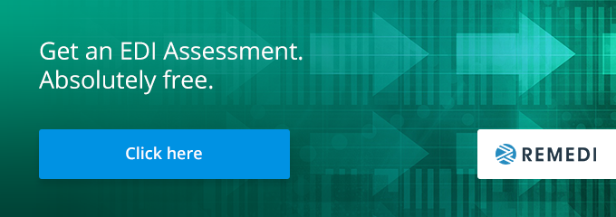
REMEDI Can Help
For a quarter of a century, REMEDI has been helping organizations find the EDI and B2B integration solutions that match their needs.
Our skilled EDI professionals offer assessments of current EDI capabilities, along with guidance and support as your EDI ecosystem evolves.
To learn about your EDI needs, get an EDI assessment absolutely free from REMEDI’s trained professionals today.
11
Provided by REMEDI - your partner in EDI and B2B Integration.
11

